Slide 1

MULTI-VARIATE TIME SERIES ANALYSIS AIR POLLUTION
Sit Dolor Amet

Slide 2
TABLE OF CONTENTS
INTRODUCTION
1.1 Scope
1.2 Business_Problem
1.3 Required_Libraries
1.4 load_the_data
1.5 Data_Library
1.6 Granger_Casuality_test
1.7 Cointegration _est
1.8 Train_test_split
VAR_model
2.1 Model_Forecasting
2.2 Manual_calculation_for_forecasting
2.3 Visualization_of_Actual_and_Predicted
2.4 Mean_Absolute_Percentage_Error
3.Lstm_Model
3.1 Model_Building

Slide 3
1. INTRODUCTION
In This Notebook we will see how we will forecast the pollution level in the air using Multivariate Time Series Data.
1.1 Scope
Poor air quality has harmful effects on human health, particularly the respiratory and cardiovascular systems. Pollutants can also damage plants and buildings, and smoke or haze can reduce visibility.
1.2 Business_Problem
Air pollution is bad for business. Around 1.2 billion workdays are lost globally each year due to air pollution, which could reach 3.8 billion days by 2060.
Employees breathing polluted air are much more likely to get sick and experience reduced cognitive performance.

Slide 4
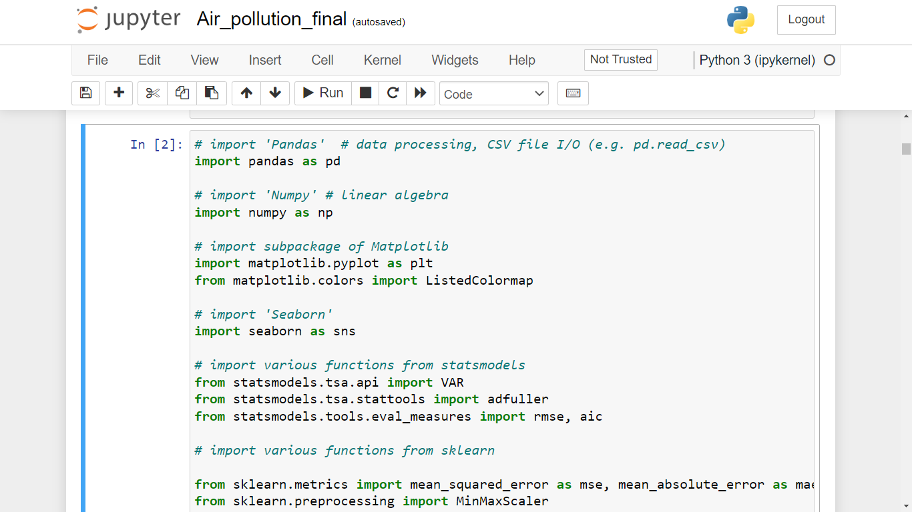
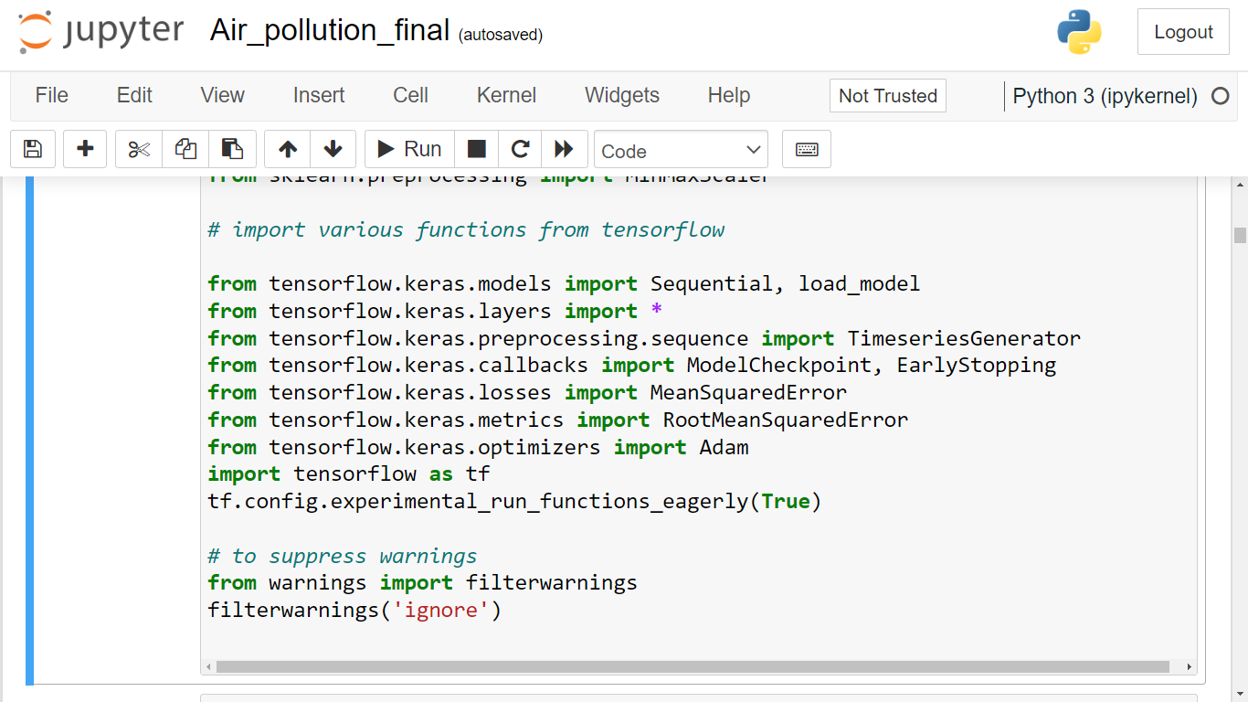
Required libraries

Slide 5
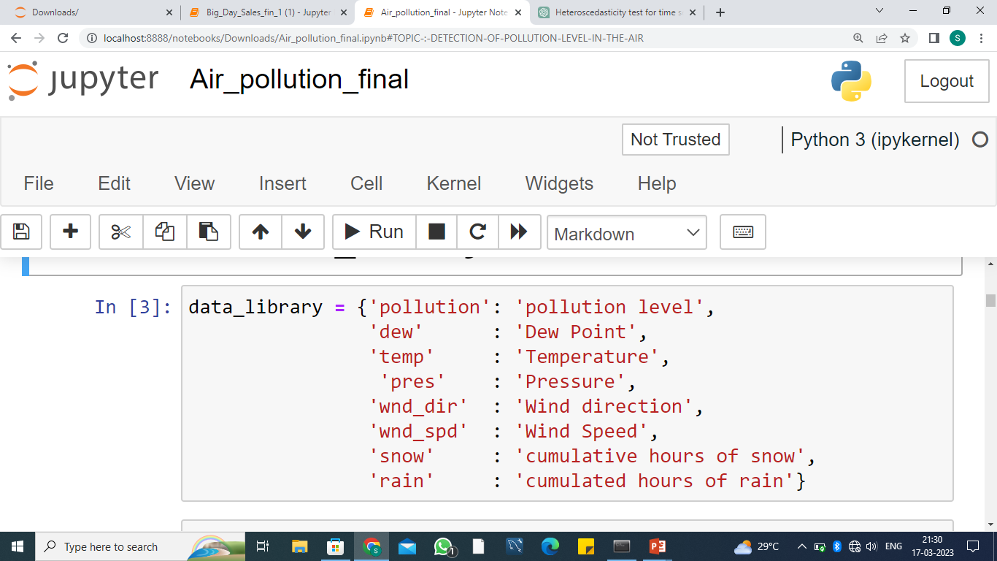

Slide 6
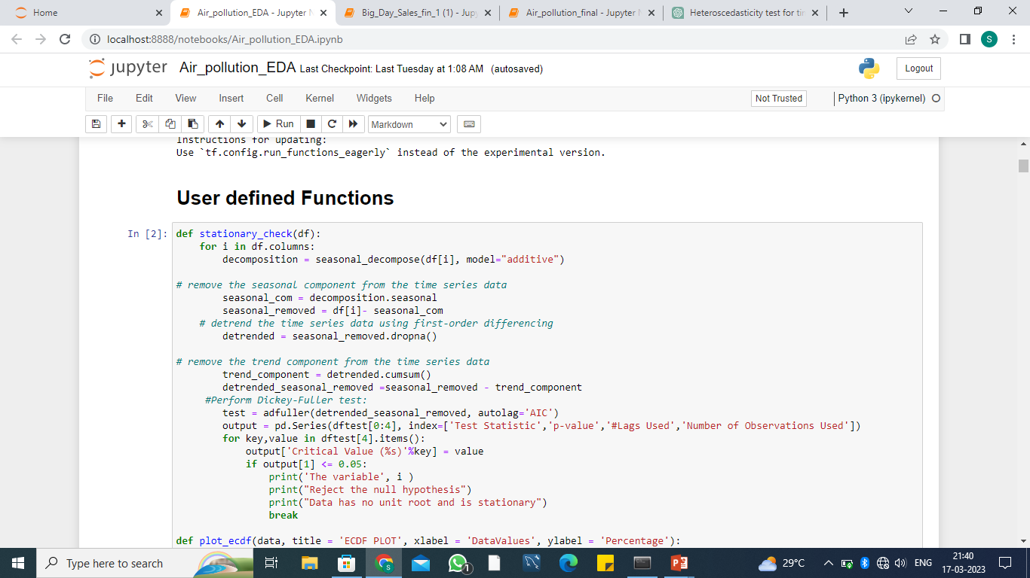
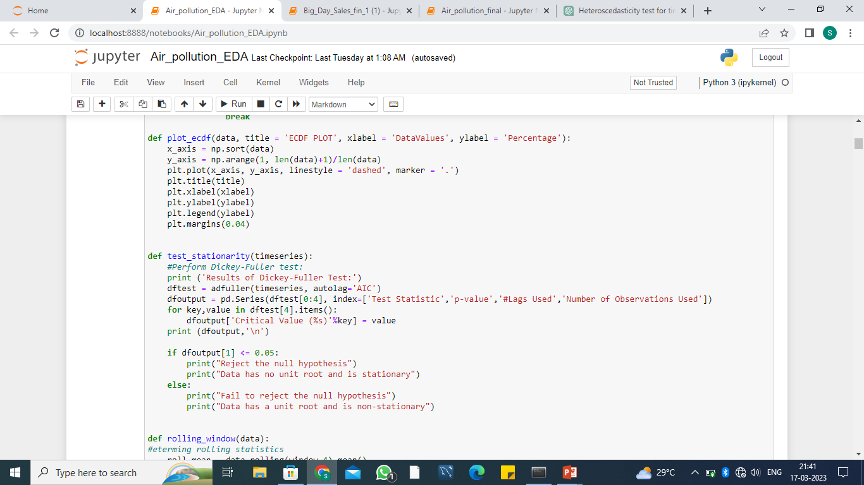

Slide 7
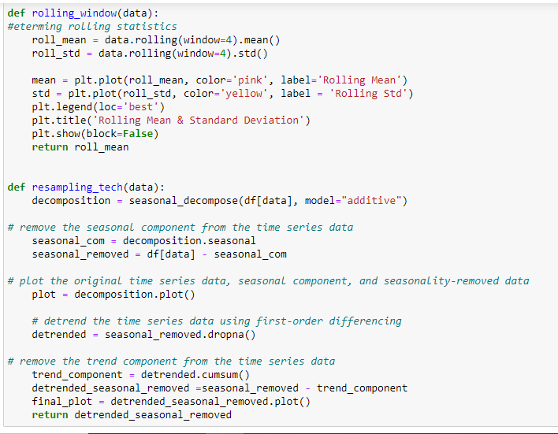

Slide 8
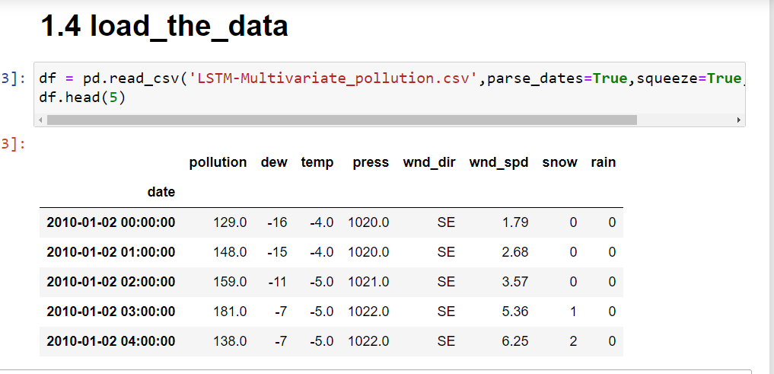
This is the Air pollution dataset. Data is in hourly basis, at the end of every hour.

Slide 9
As we have a wind direction column as categorical so we change this into numerical
from sklearn.preprocessing import labelencoder
# initialize the label encoder
le = labelencoder()
# fit and transform the data
df_sam['wnd_dir'] = le.fit_transform(df_sam['wnd_dir'])

Slide 10
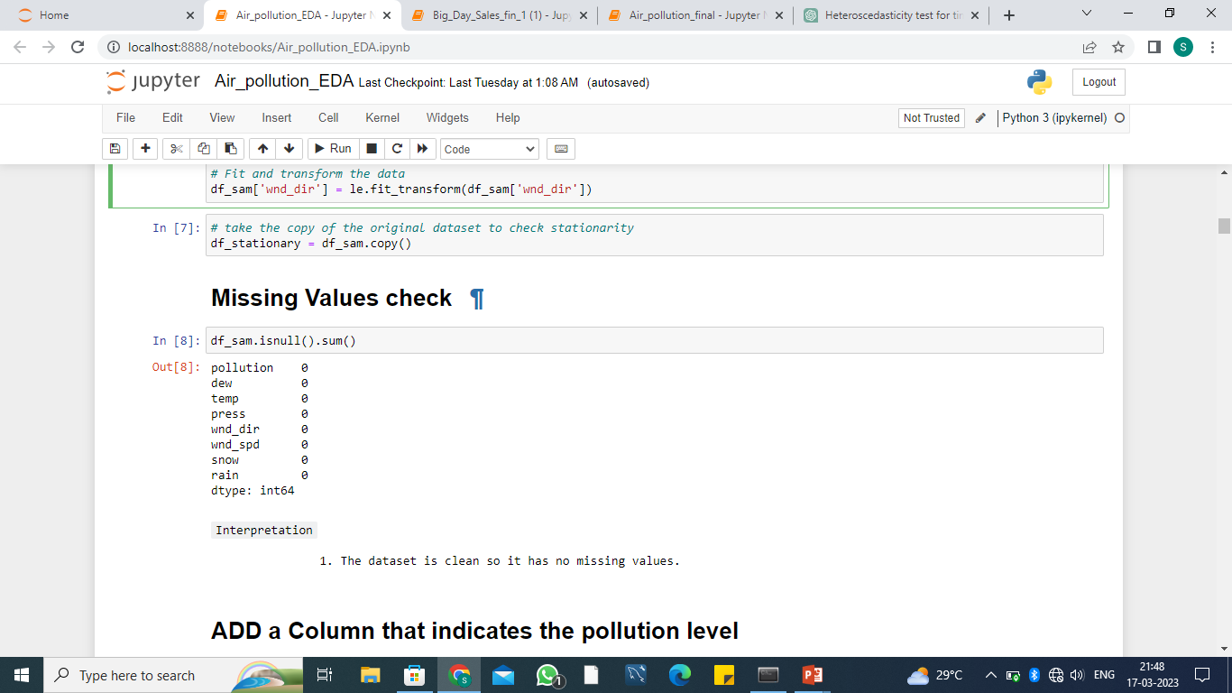
Missing values

Slide 11
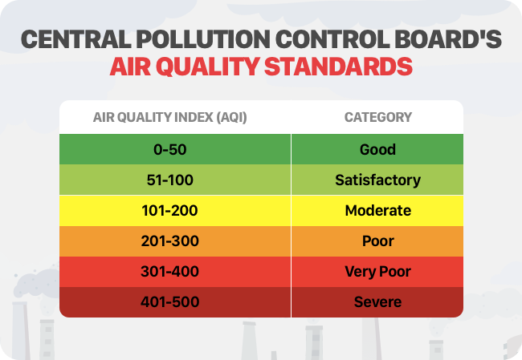
ADD a Column that indicates the pollution level
indicators = {
'good': df_sam['pollution'].between(0, 51),
'satisfactory': df_sam['pollution'].between(51, 101),
'moderate': df_sam['pollution'].between(101, 201),
'poor': df_sam['pollution'].between(201, 301),
'very_poor': df_sam['pollution'].between(301, 401),
'severe': df_sam['pollution'].between(401, 501),
'danger': df_sam['pollution'].values > 501
}
df_sam['pollu_indicators'] = np.select(indicators.values(), indicators.keys())

Slide 12
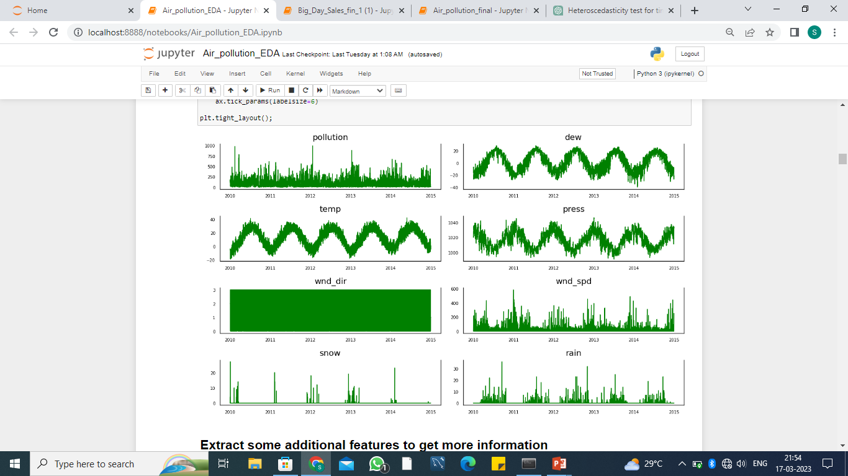
These are the data distribution column wise

Slide 13
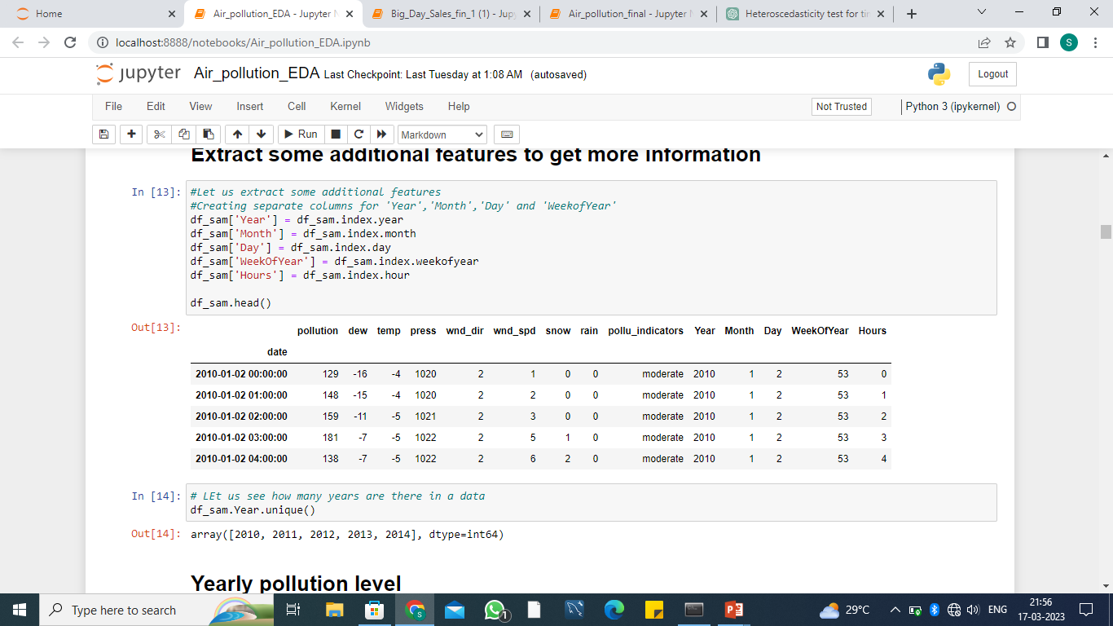
Make date column as index and add some more column to analyze the data more efficiently

Slide 14
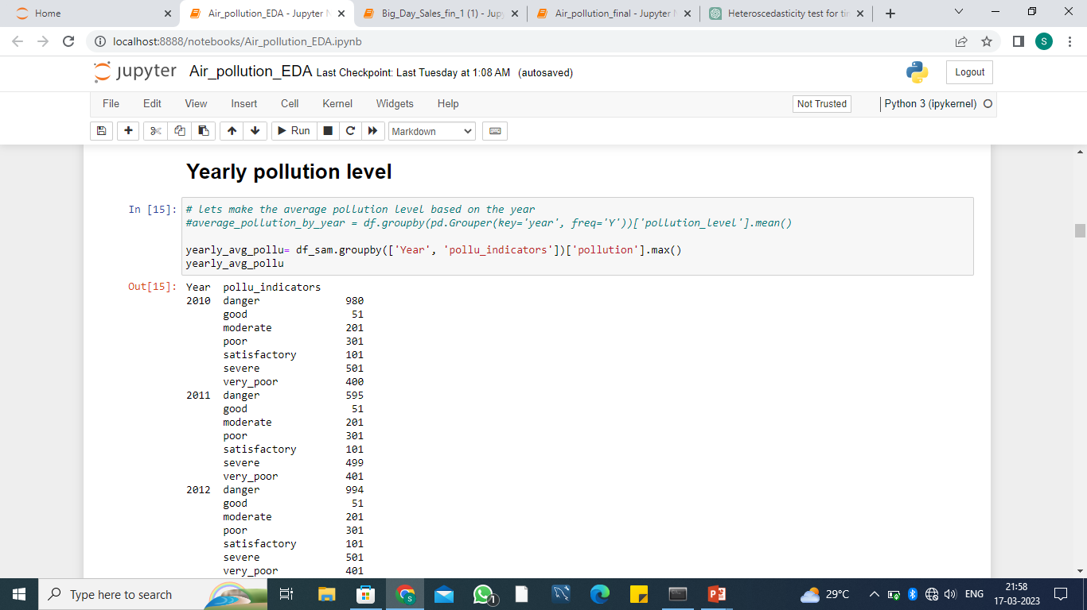
Interpretation
1. As per the Central pollution Control Board our data has a value above satisfactory level. 2. In ``2012`` is the most polluted year among all. Here central board level of high is only upto 500 but here above the estimation so considered this as a most polluted year

Slide 15
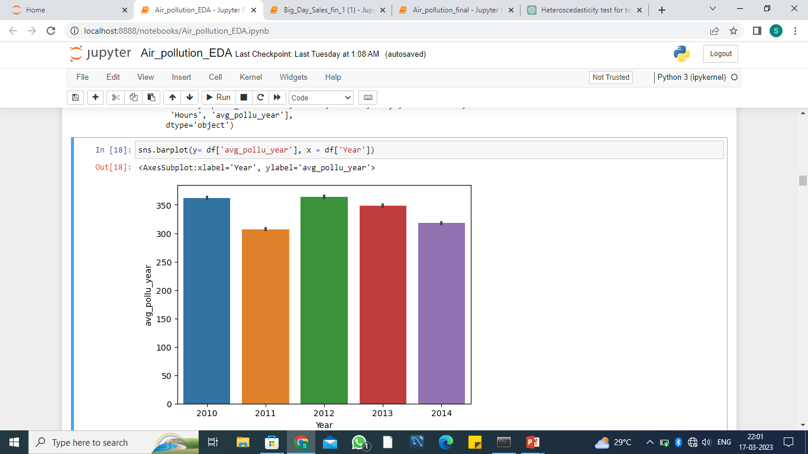

Slide 16
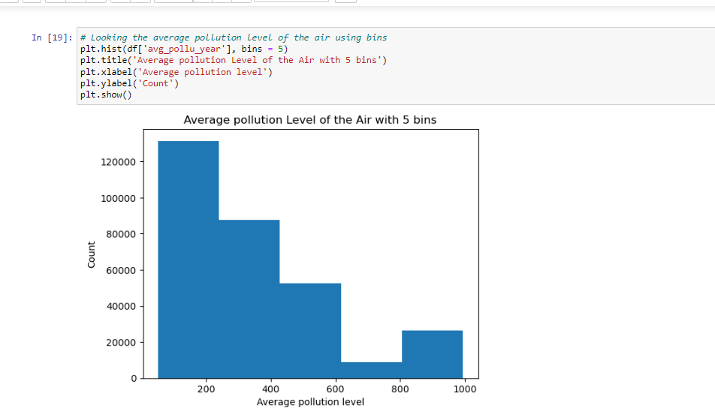

Slide 17
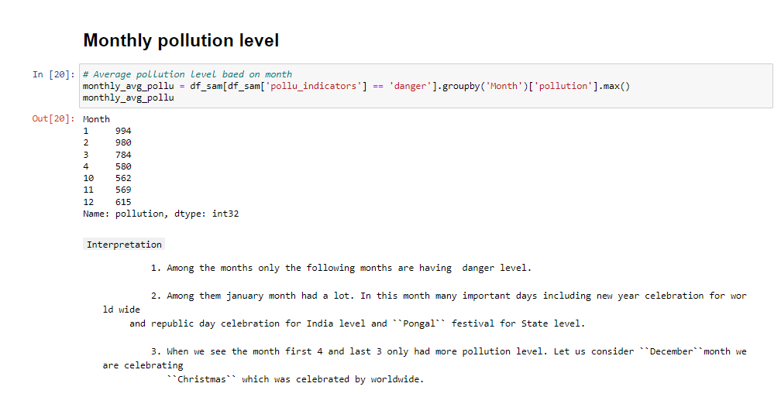

Slide 18
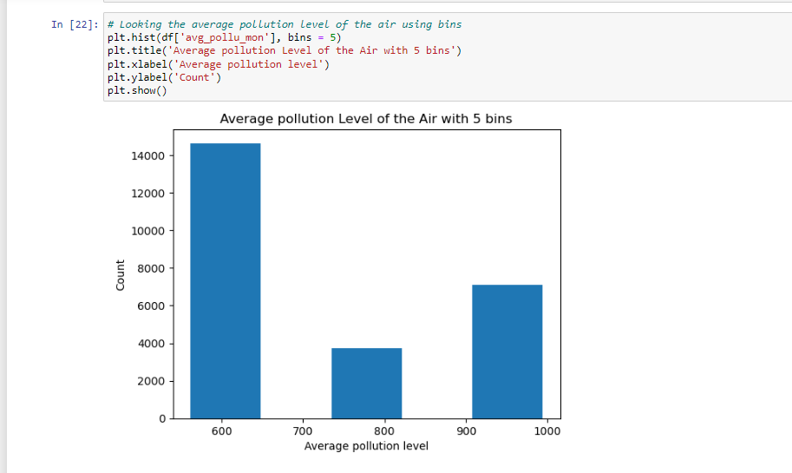

Slide 19
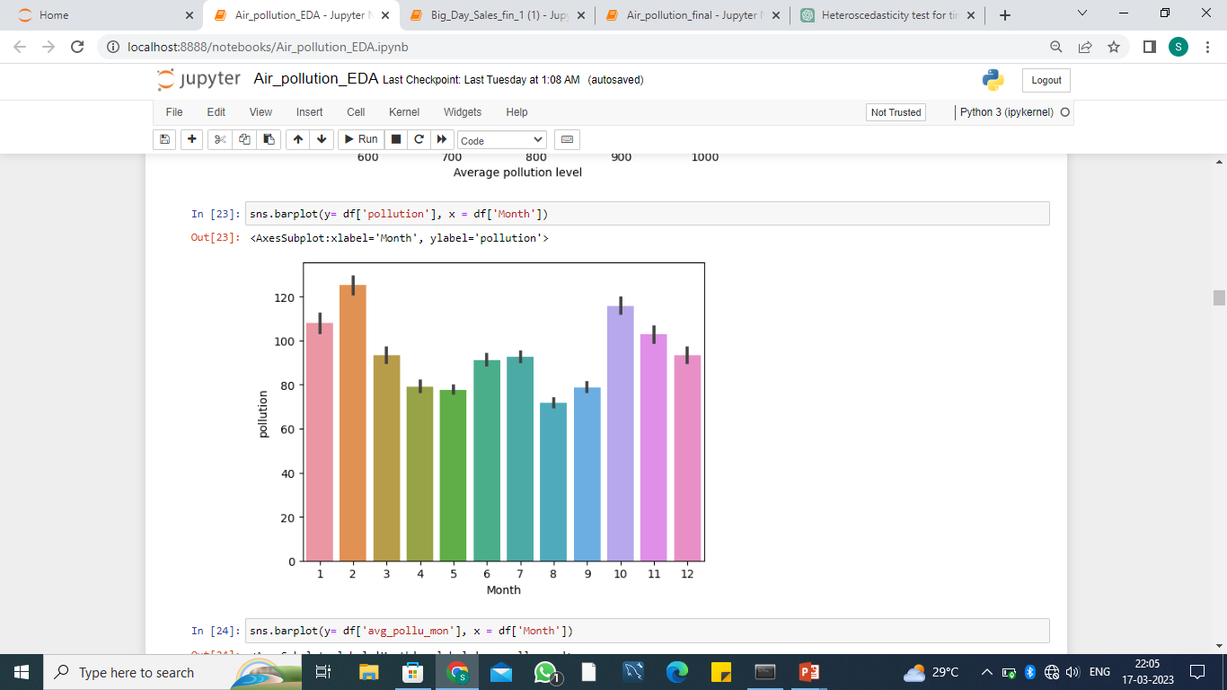

Slide 20
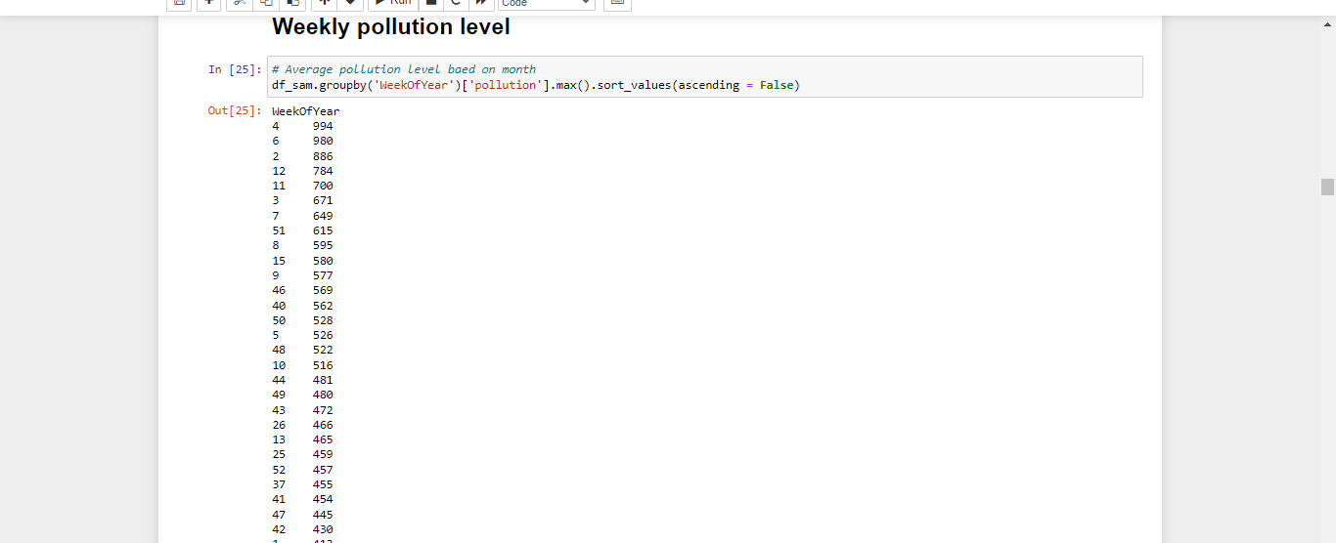
Interpretation
1. This gives the week wise maximum pollution level among the years given. 2. Among them 4th week has the most level of pollution.

Slide 21
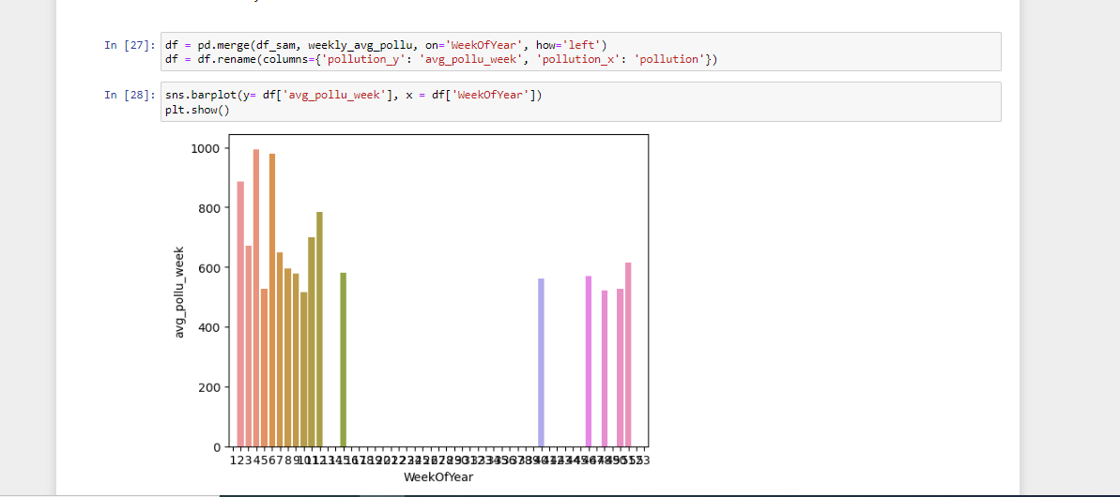

Slide 22
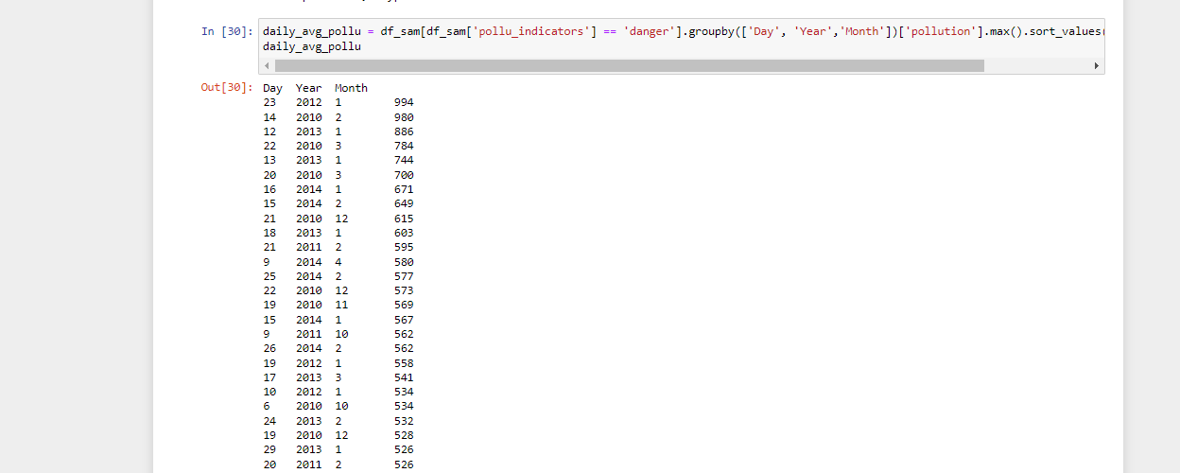
Interpretation
1. From this groupby In the year ``2012`` ``January`` month 23 rd is a Monday. 2. Monday all of them returning school, offices, etc.. So in terms of days Monday had most pollution level. 3. The second highest level of pollution in the year ``2010`` ''Febrary`` month 14th is the 2nd highest that is ``Valentinesday`` which was celebrated by whole world. 4. The Third highest level of pollution in the year ``2013`` `` January`` month 12th that is ``saturday``.

Slide 23
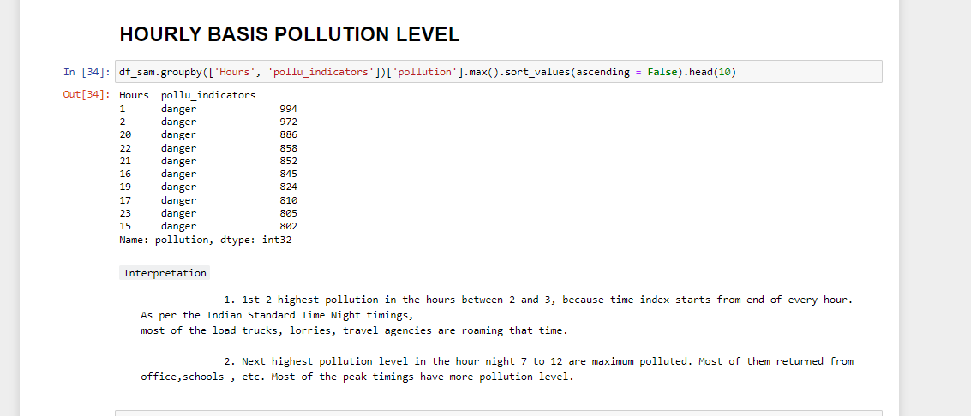

Slide 24
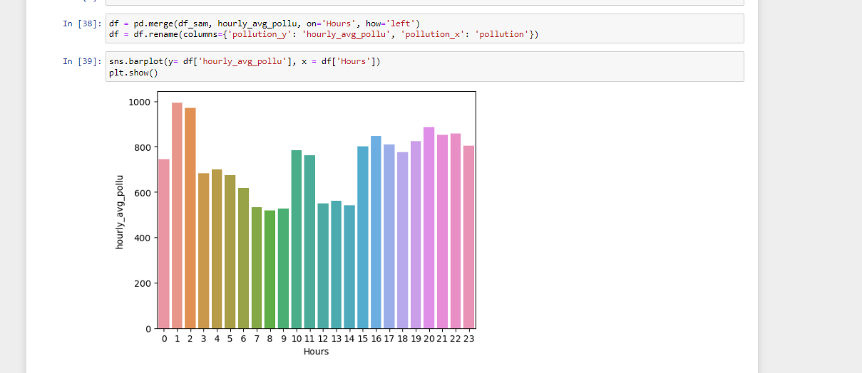

Slide 25
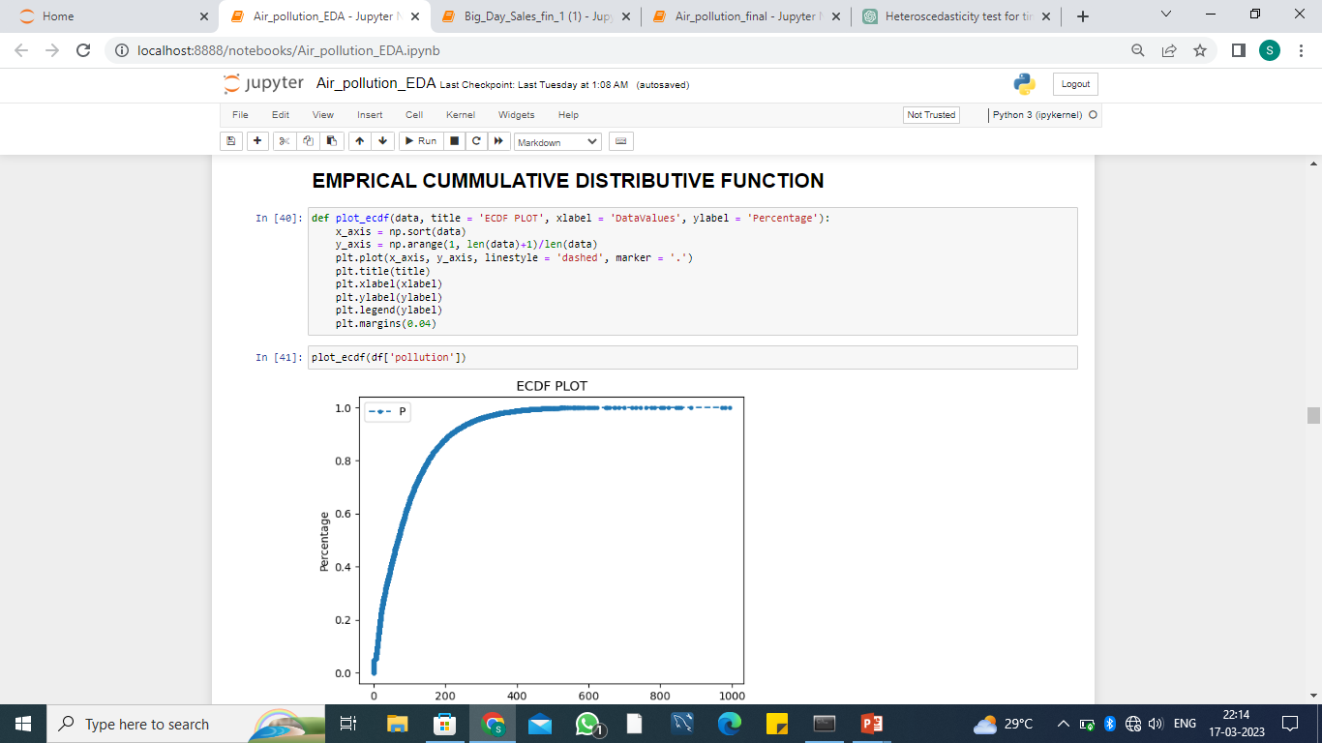

Slide 26
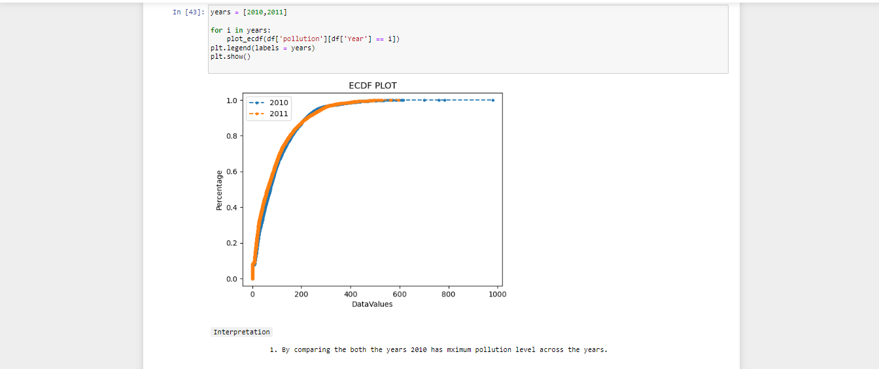

Slide 27
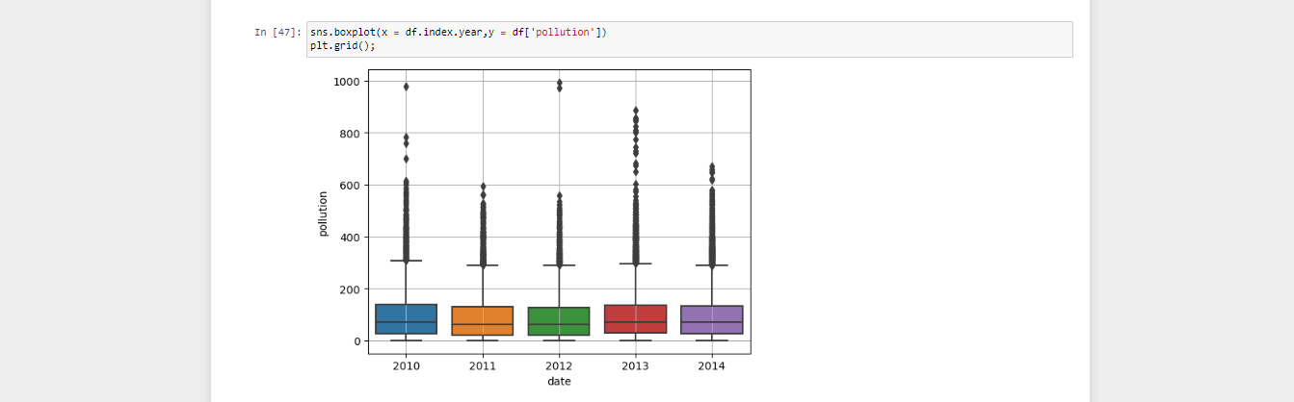
outliers

Slide 28
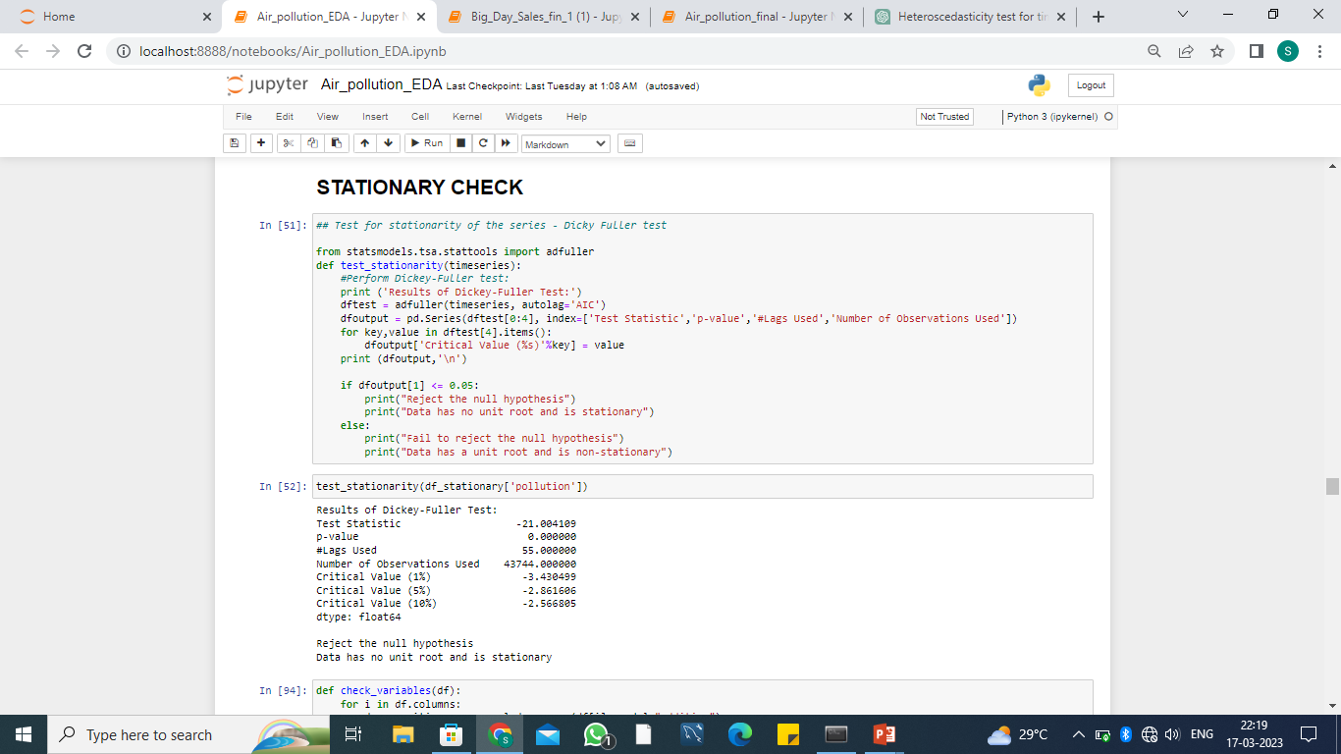
stationarity means that the statistical properties of a process generating a time series do not change over time . It does not mean that the series does not change over time, just that the way it changes does not itself change over time.

Slide 29
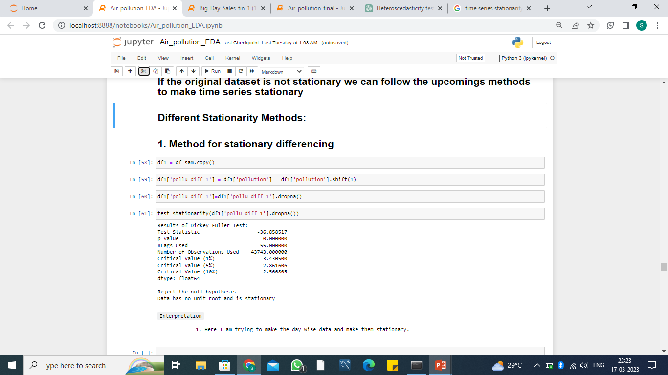
If the original dataset is not stationary we can follow the upcomings methods to make time series stationary

Slide 30
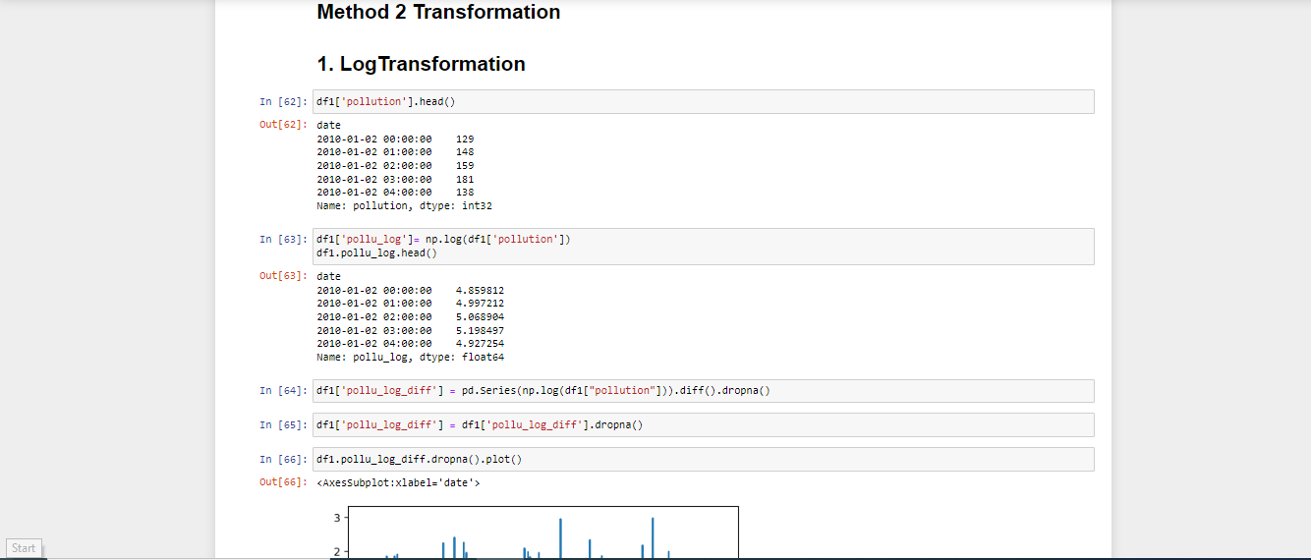

Slide 31
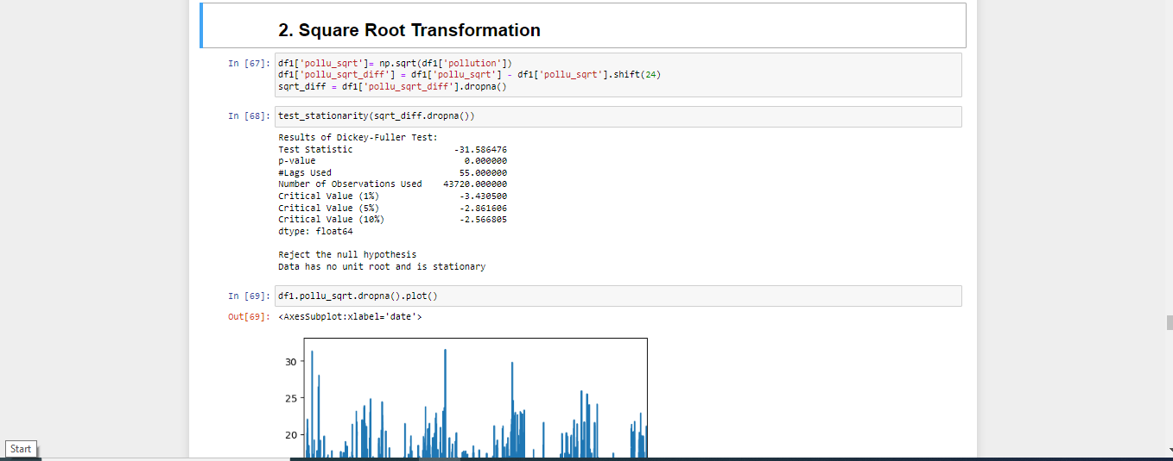

Slide 32
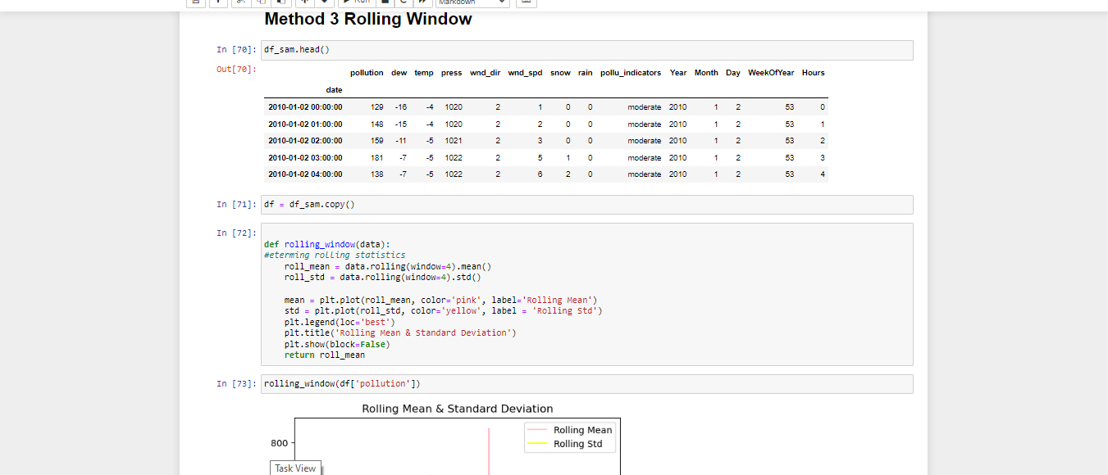

Slide 33
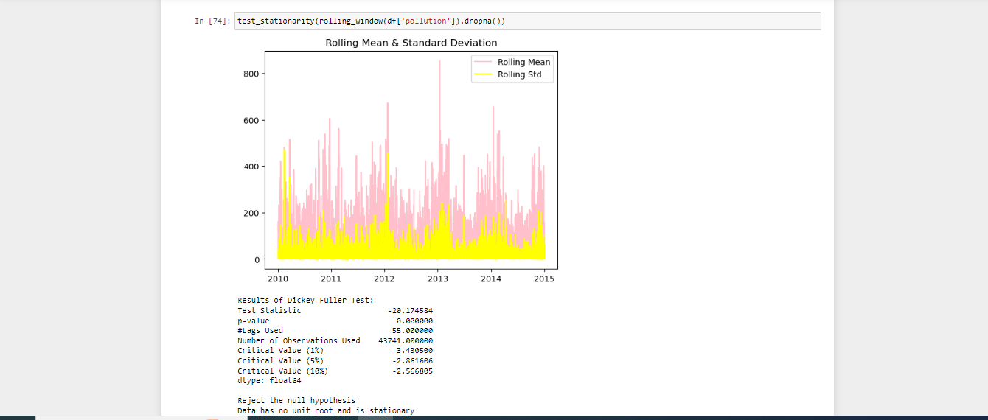

Slide 34
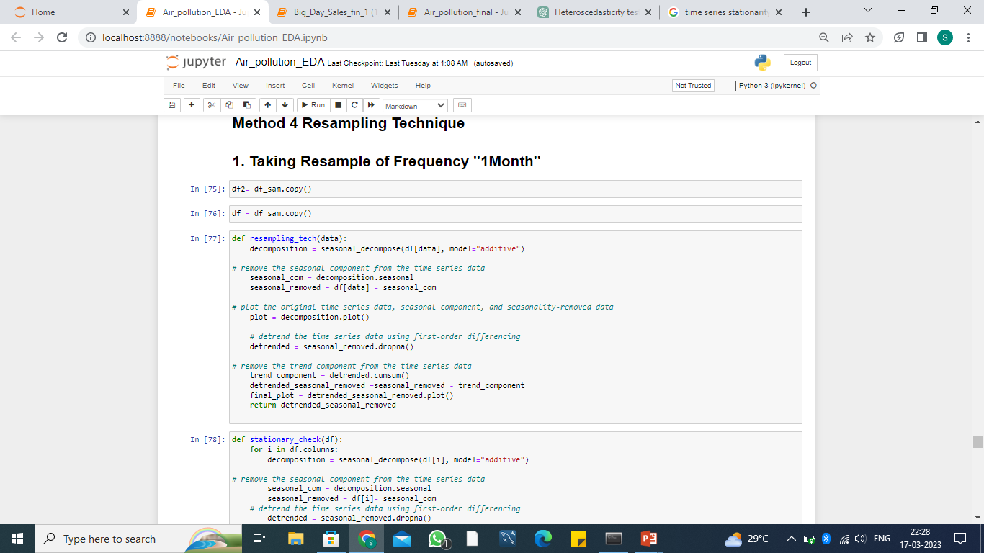

Slide 35
IMPORTANT KEY POINTS
``PROBLEMS ``
1. As per the Central pollution Control Board our data has a value above satisfactory level.
2. In ``2012`` is the most polluted year among all. Here central board level of high is only upto 500 but here above the estimation so considered this as a most polluted year.
3. Among them january month had a lot. In this month many important days including new year celebration for world wide and republic day celebration for India level and ``Pongal`` festival for State level.
4. When we see the month first 4 and last 3 only had more pollution level. Let us consider ``December``month we are celebrating ``Christmas`` which was celebrated by worldwide.
5. From this groupby In the year ``2012`` ``January`` month 23 rd is a Monday. Monday all of them returning school, offices, etc.. So in terms of days Monday had most pollution level.
6. The second highest level of pollution in the year ``2010`` ''Febrary`` month 14th is the 2nd highest that is ``Valentinesday`` which was celebrated by whole world.
7. The Third highest level of pollution in the year ``2013`` `` January`` month 12th that is ``saturday``.

Slide 36
``Effects``
1. Cardiovascular Diseases,
Cancer.
Neurological Disorders.
Gastrointestinal Disorders.
Kidney Diseases.
Liver Diseases.
Skin Diseases.
Asthma.
These are the some of the major diseases caused by air pollution.

Slide 37
``Solutions``
1. Raising awareness: Raising awareness about the health impacts of air pollution and encouraging individuals to take action can help build public support for policies and initiatives to reduce air pollution.
2. The above mentioned days are more polluted days and months. Taking consideration into that days and take preventive measures for future days
3. Planting trees: Trees absorb carbon dioxide and other pollutants from the air, making them an effective natural solution to air pollution. Planting more trees in urban areas can also help reduce the urban heat island effect.
4. Improving indoor air quality: Indoor air pollution can also be a problem, especially in homes with poor ventilation. Improving indoor air quality through better ventilation and air filtration systems can help reduce exposure to pollutants.

Slide 38
1.6 Granger_Casuality_test
Granger causality test is a statistical test that determines if one time series is useful in forecasting another time series.
It tests the null hypothesis that the coefficients of the past values of one time series in a regression equation are zero, indicating that the past values of that time series do not significantly contribute to predicting the other time series.

Slide 39
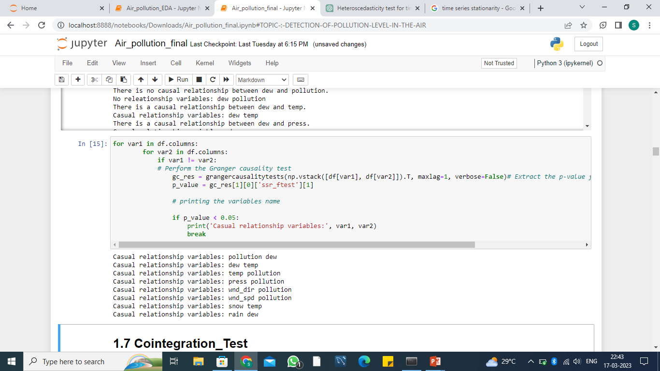

Slide 40
1.7 Cointegration_Test
Cointegration test is a statistical test used to check the presence of a long-run relationship between two or more non-stationary time series. It is used when two or more time series are highly correlated in the short run, but not in the long run.
The steps involved in a cointegration test are as follows:
Check if the individual time series are stationary using a unit root test, such as the Augmented Dickey-Fuller (ADF) test.
If any of the time series are found to be non-stationary, take the first difference of the series to make them stationary.
Conduct a regression analysis using the stationary time series to test for cointegration. This can be done using techniques such as the Johansen test or the Engle-Granger two-step method.
If cointegration is detected, interpret the result as indicating that there exists a long-run relationship between the time series.

Slide 41
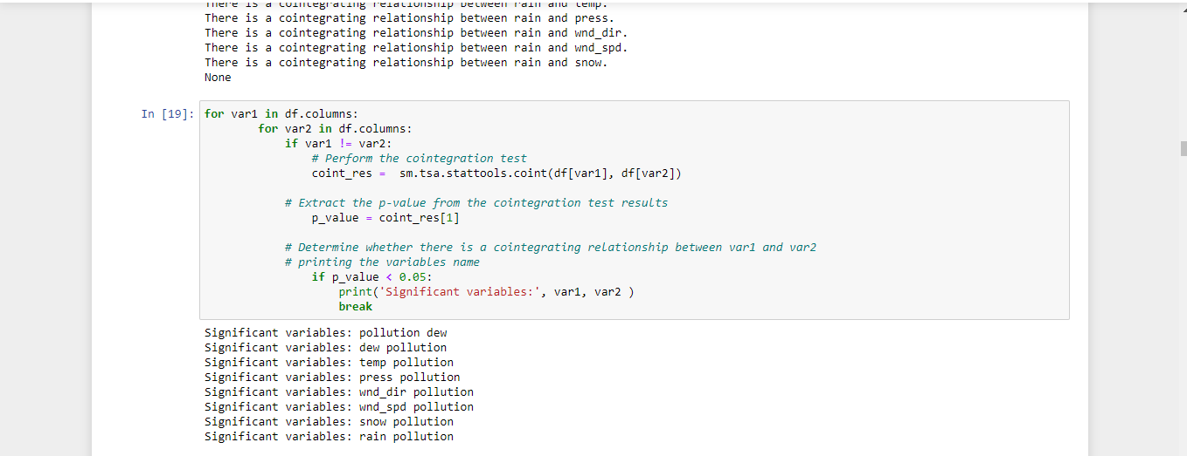

Slide 42
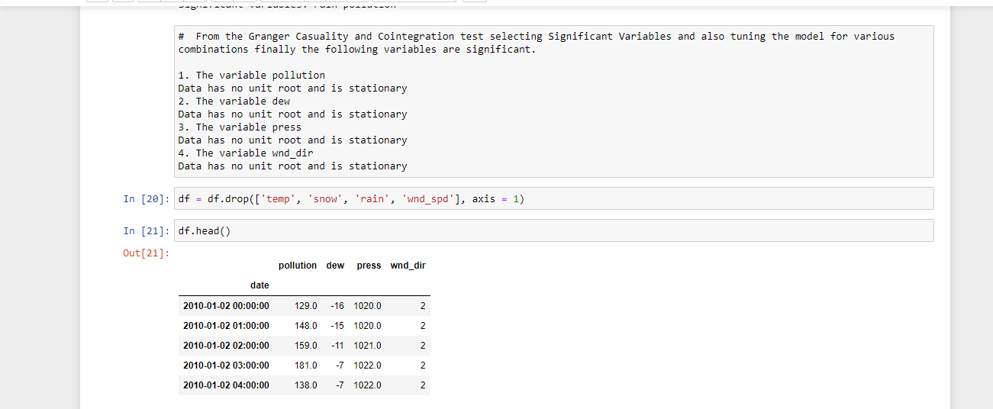

Slide 43
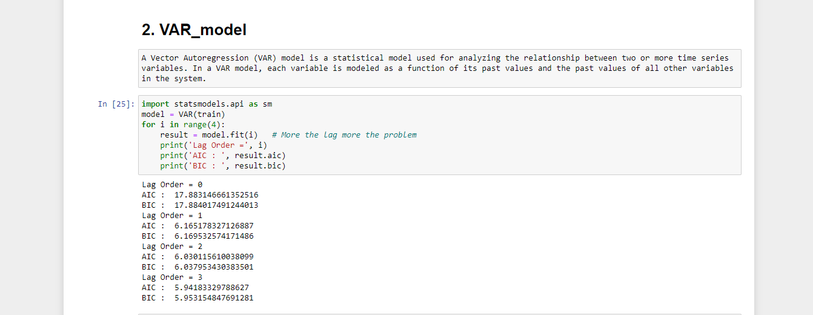

Slide 44
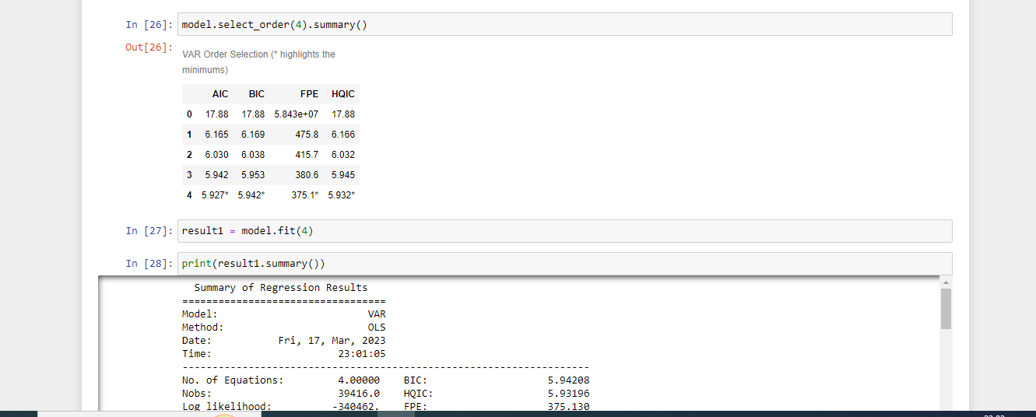

Slide 45
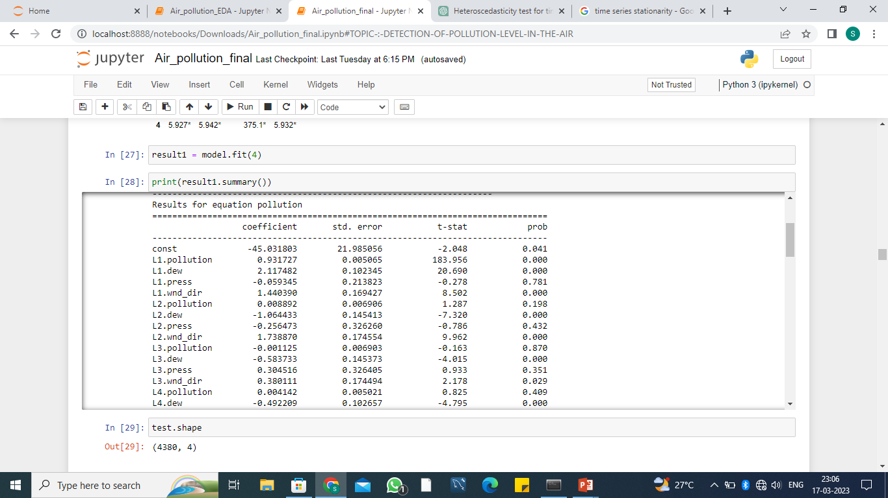

Slide 46
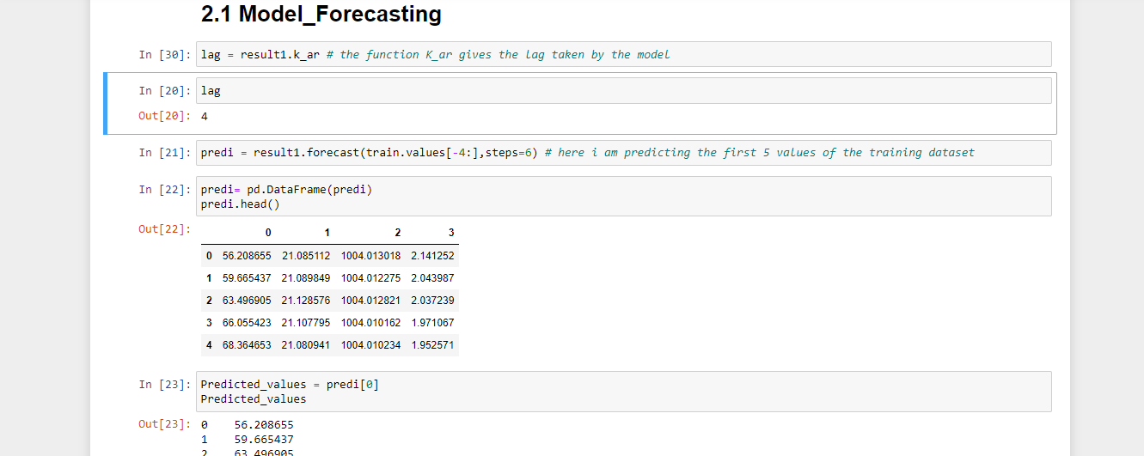

Slide 47
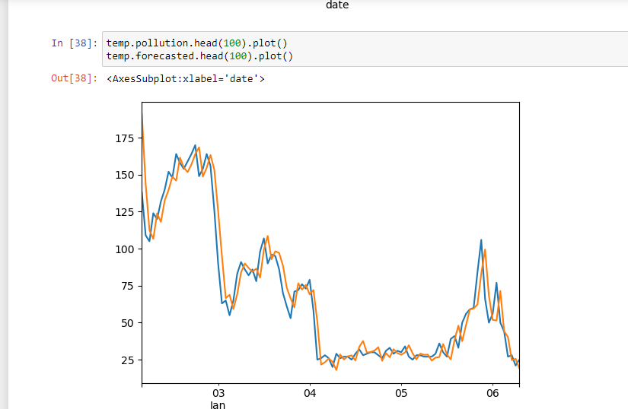

Slide 48
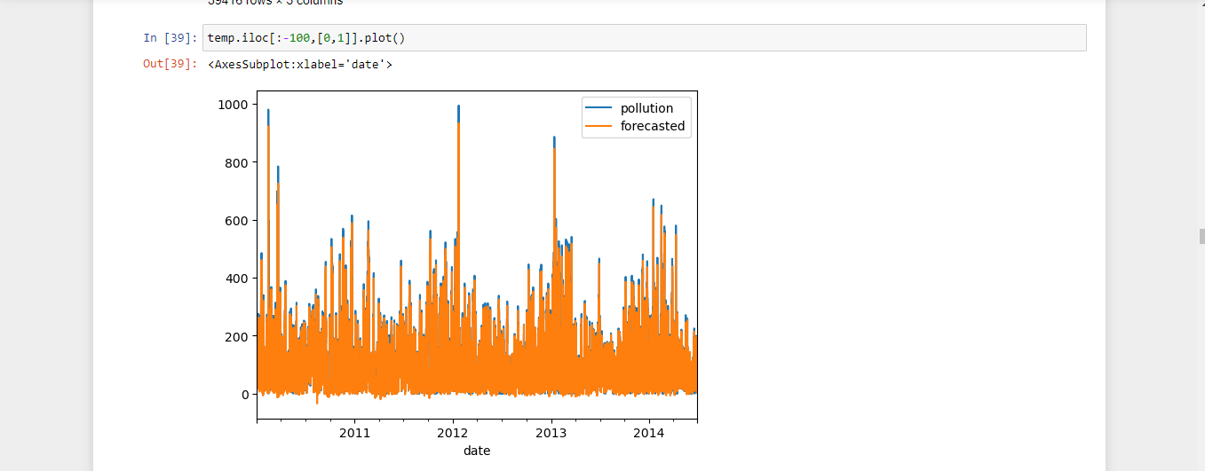

Slide 49
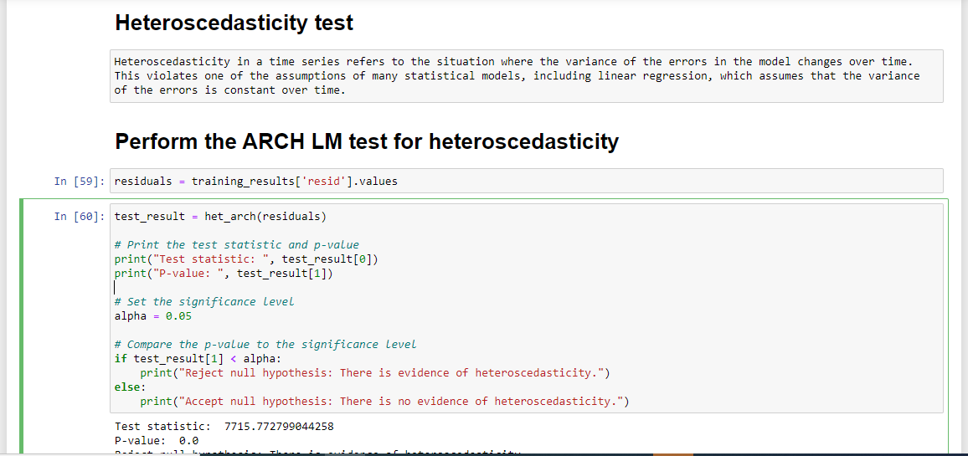

Slide 50
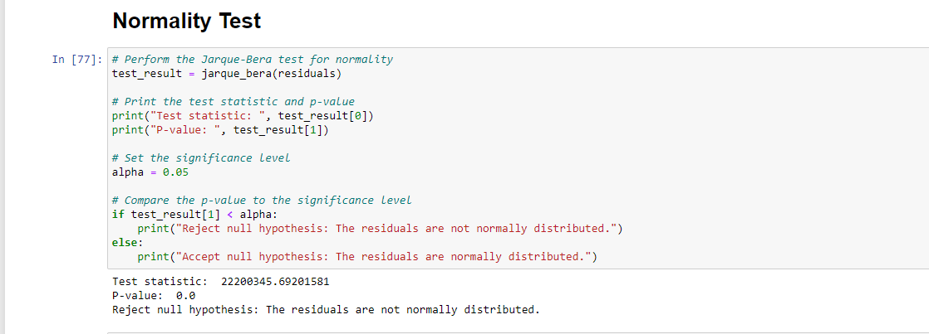

Slide 51
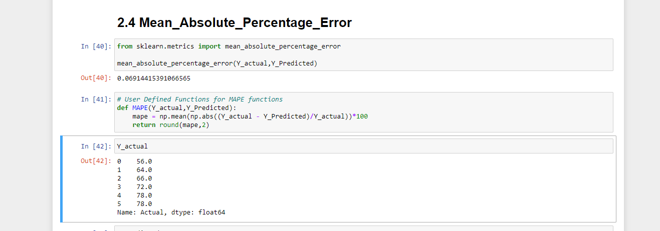

Slide 52
LSTM MODEL:
“The LSTM cell adds long-term memory in an even more performant way because it allows even more parameters to be learned. This makes it the most powerful [Recurrent Neural Network] to do forecasting, especially when you have a longer-term trend in your data.

Slide 53
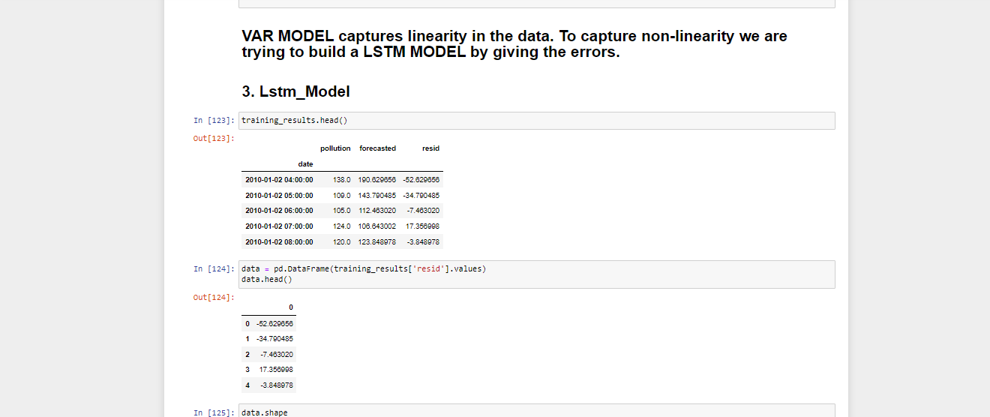

Slide 54
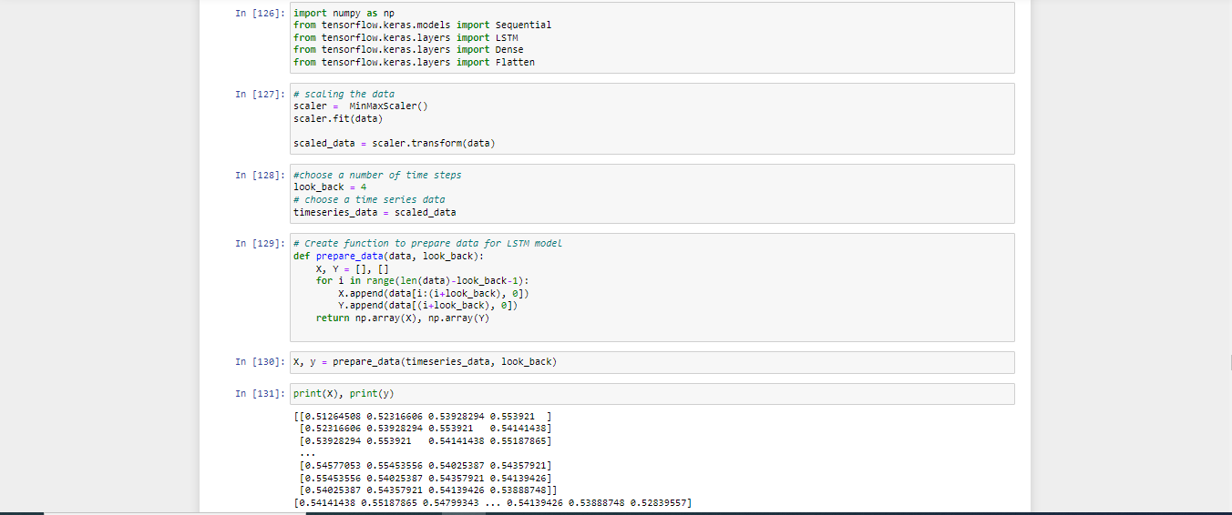

Slide 55
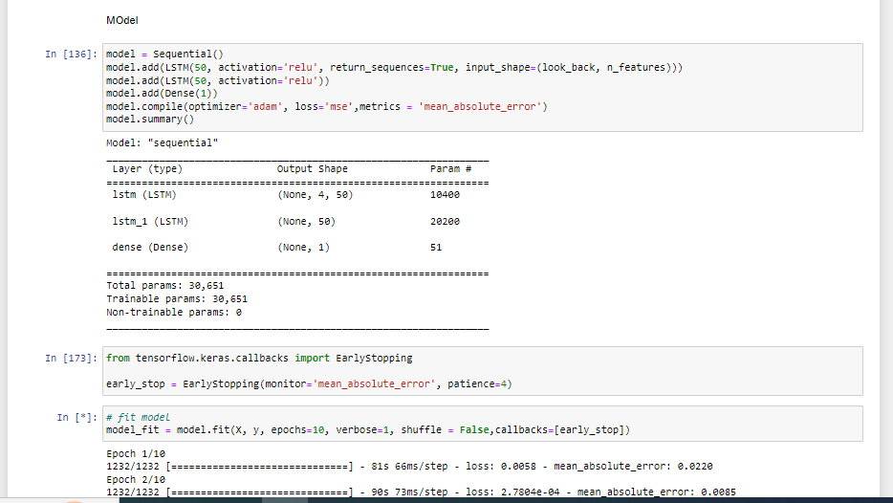

Slide 56
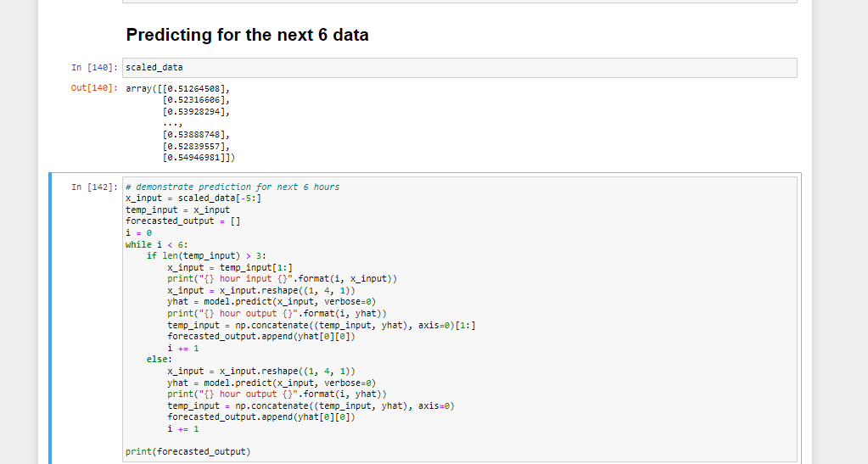

Slide 57
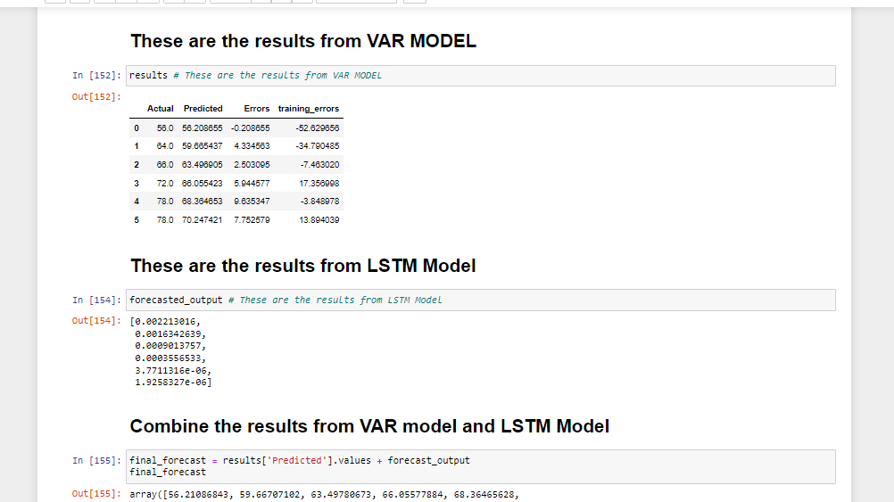

Slide 58
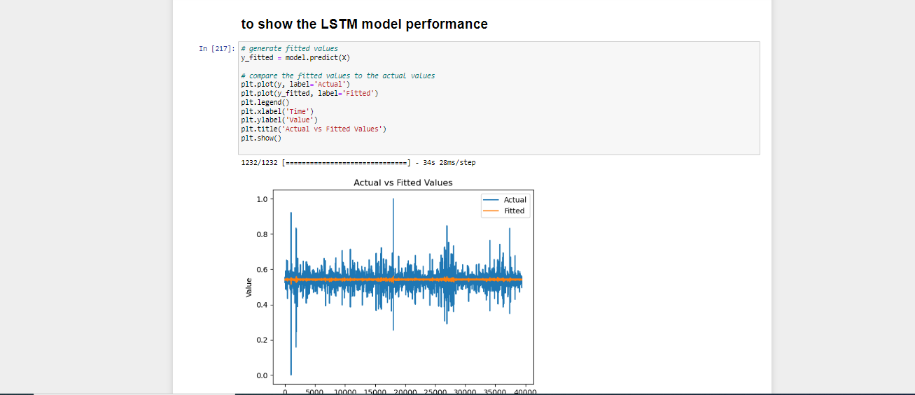

Slide 59


Slide 60


Slide 61

THANK YOU

